Slide 1


Data Mining Project- Group 6
Project Title: Online Retail Customer Segmentation
Ashwini Deshmukh (1002125106)
Deepan Akash Don Bosco (1002148522)
Nicholas Kingston (1001523093)
Swathi Manjunatha (1002162937)

Slide 2
Business Context and Problem Statement
Business Context
Our project focuses on a UK-based online retail store aiming to optimize customer segmentation. By understanding customer behavior, the company can deliver personalized marketing strategies, improve customer retention, and maximize revenue.
Business Problem Statement
How can we group customers effectively based on their purchasing behavior to enhance targeted promotions, increase customer satisfaction, and boost overall sales performance?

Slide 3
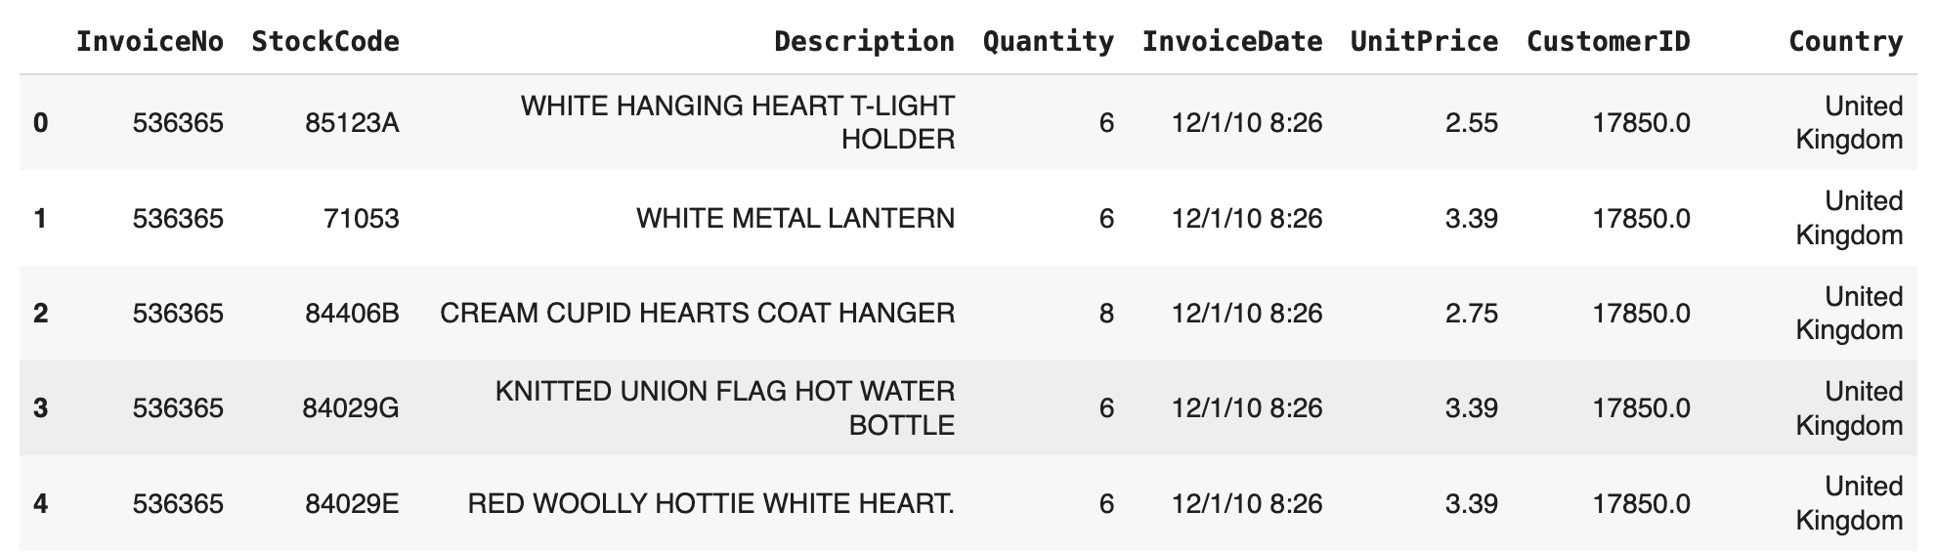
Tackling the Business Problem
Challenges with Conventional Managerial Insights:
Traditional managerial approaches categorize customers broadly, using generic promotions. This often fails to uncover nuanced patterns such as loyalty, spending, and inactivity. (e.g., Broad campaigns lead to overspending on low-value customers)
Focus on RFM-based segmentation to uncover customer behavior.
Apply unsupervised learning techniques to identify unique customer groups.
Combine data-driven insights with tailored business strategies to maximize engagement and revenue.
Dataset Source from Kaggle – contains 500,000+ transactions from a UK-based online retailer (Dec 2010-Dec 2011).
The company caters to a diverse customer base, including individual buyers and wholesalers.
Tools: Python, clustering algorithms, and visualization techniques.
Our Approach:
Available Resources:

Slide 4
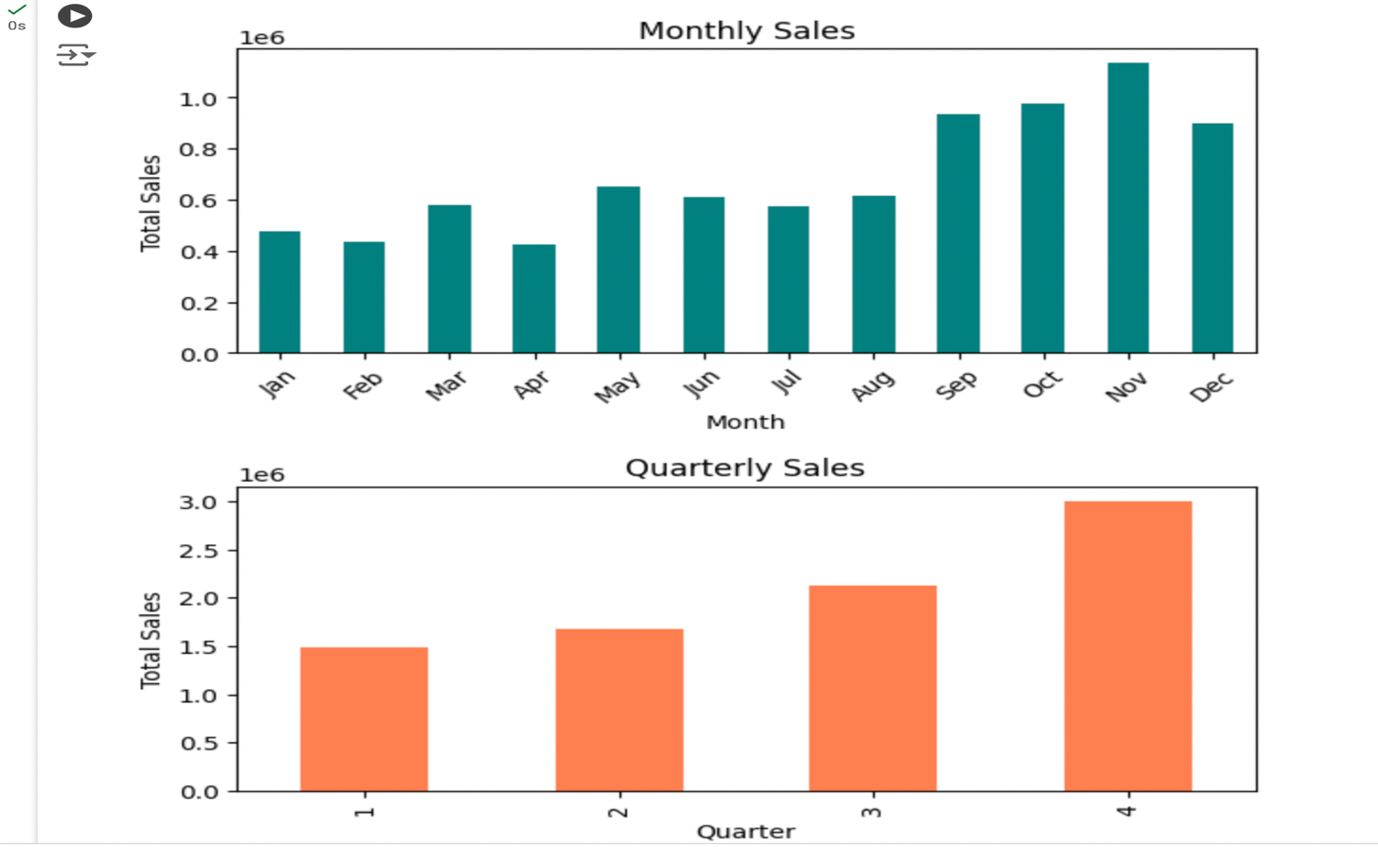
Data Overview and Preprocessing
Data Description
NAME | DESCRIPTION | TYPE
InvoiceNo | Unique identifier for each invoice | Numeric
StockCode | Unique identifier for each product | Numeric
Description | Description of the product | Textual
Quantity | Quantity of the product purchased | Numeric
InvoiceDate | Date and time when the invoice was generated | Datetime
UnitPrice | Price of a single unit of the product | Numeric
CustomerID | Unique identifier for the customer | Numeric
Country | Country where the customer is located | Categorical
Includes transactional data containing 541,909 transactions from an online retailer with 8 features as in table.
Contains Unique, all-occasion gifts with a significant wholesale customer base.
Data Cleaning: Removed missing values for CustomerID
Feature Engineering:
Added TotalPrice (Quantity * UnitPrice) for spending analysis.
Extracted Month, Quarter, Day of Week and Hour from InvoiceDate
Normalization: StandardScaler applied to RFM metrics
Aggregated data to create RFM Metrics:
Recency: Days since last purchase.
Frequency: Number of purchase invoices.
Monetary: Total spending.
Trends: Peak sales observed in October-December (Q4).
Patterns: High customer activity on Thursdays.
Afternoon hours show the most engagement.
Preprocessing
Exploratory Data Analysis (EDA)

Slide 5
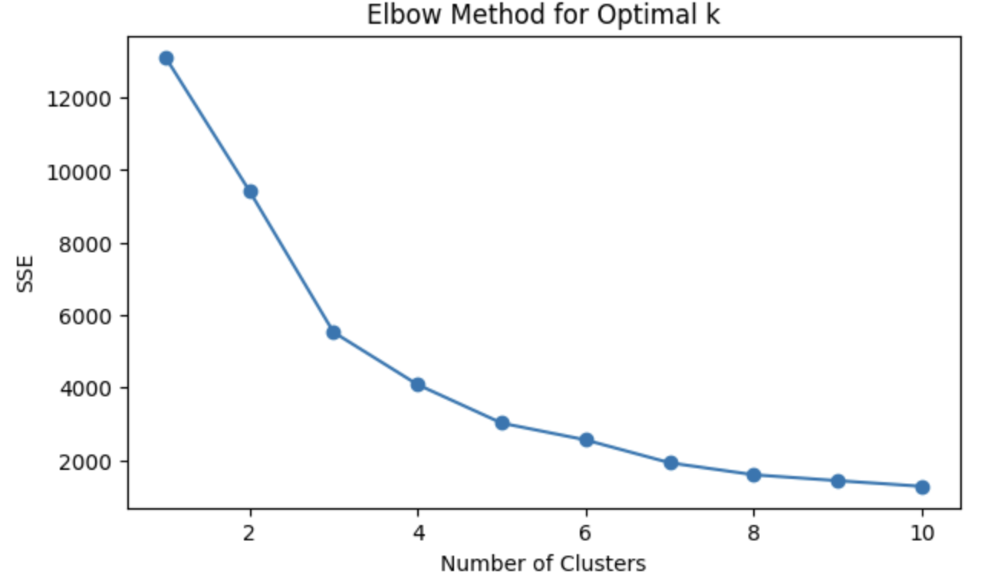
Data Mining Models
Data Aggregation
Exploratory Data Analysis (EDA)
Clustering for Segmentation
Outlier removal & Model refinement
Insights and Recommendations
Used to segment customers into distinct groups based on their Recency, Frequency, and Monetary (RFM) metrics.
Customers were grouped by minimizing differences within clusters and maximizing differences between clusters. Centroids represent each cluster's average traits for easy interpretation. The Elbow Method identified 3 clusters [domain expertise decide to take 3] as optimal for business relevance.
Used to validate K-Means results and visualize customer relationships through a dendrogram.
Customers were grouped by splitting clusters based on similarities using Ward linkage to minimize variance. A dendrogram guided the selection of 3 clusters for consistency with K-Means.
K-Means Clustering
Hierarchical Clustering

Slide 6
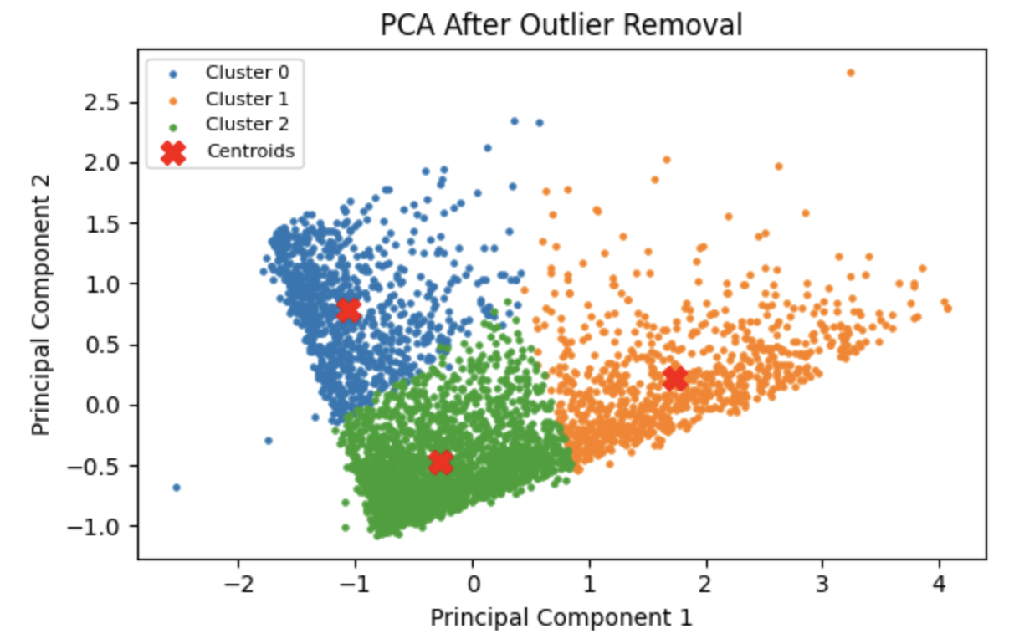
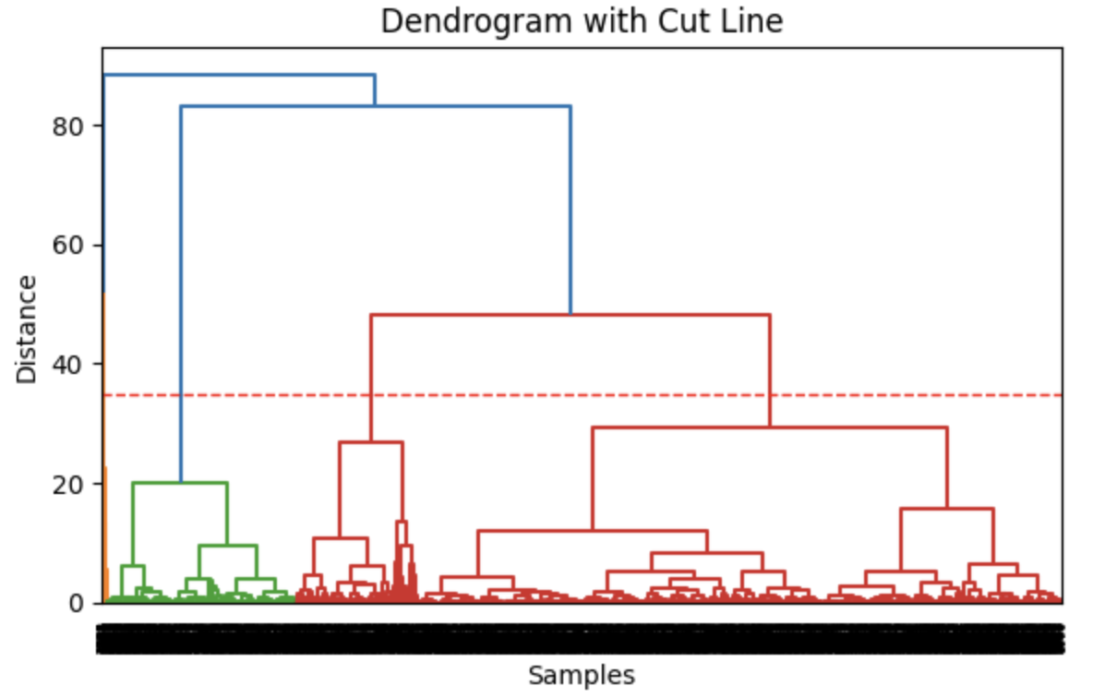
Detailed Model Description
K-Means Clustering:
With optimal k=3, used PCA to reduce dimensions and visualize clusters in 2D space.
Identified initial rectangular edges in PCA plots, smoothed out clusters by removing outliers (~692 customers).
Post-outlier removal, clusters showed improved cohesion (3.35) and separation (9.61).
Why: Scalable, efficient for large datasets, and interprets customer segments via centroids.
Hierarchical Clustering:
Generated a dendrogram using Ward’s linkage & Euclidean distance to assess cluster relationships.
Horizontal cut at 35 distance indicated a 3-cluster solution consistent with K-Means results.
Applied Agglomerative Clustering for grouping customers into 3 hierarchical clusters.
Why: Validates K-Means and visualizes customer relationships with dendrograms.

Slide 7
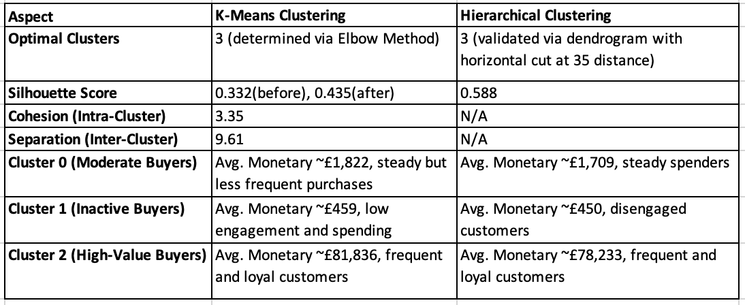
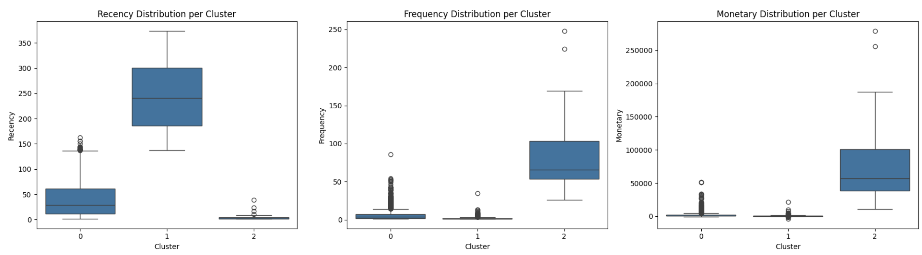
Results and Model Evaluation
Model Selection:
K-Means was chosen for its scalability, computational efficiency, and clear centroid-based clusters align with business strategies, offering actionable insights.
Hierarchical Clustering, while offering slightly better silhouette scores, is less suitable for large datasets and lacks adaptability for real-time updates.

Slide 8
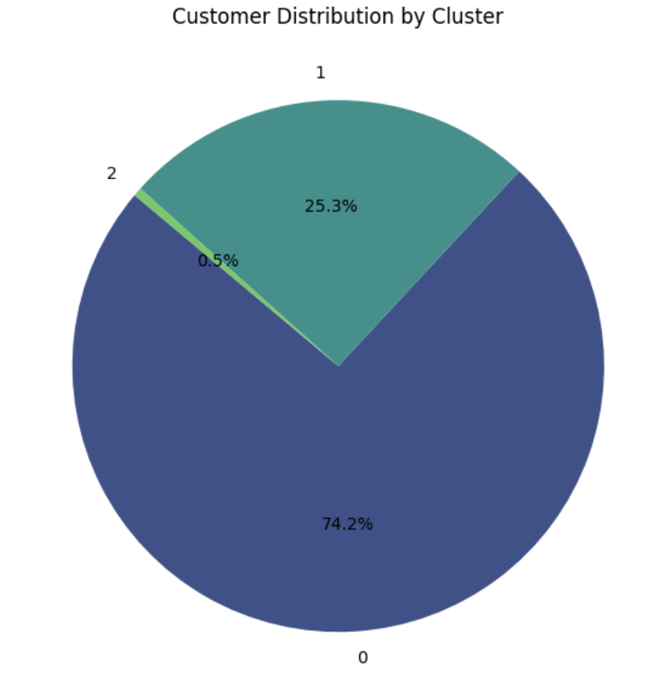
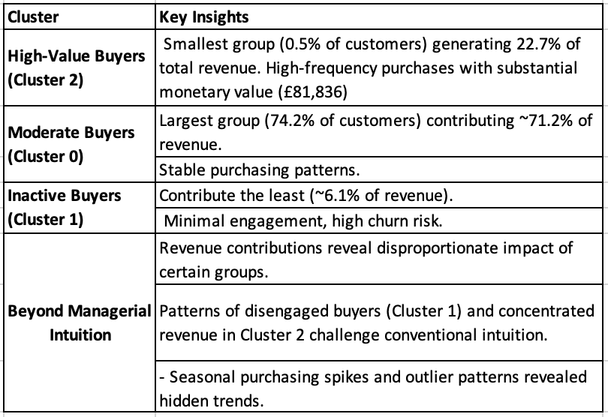
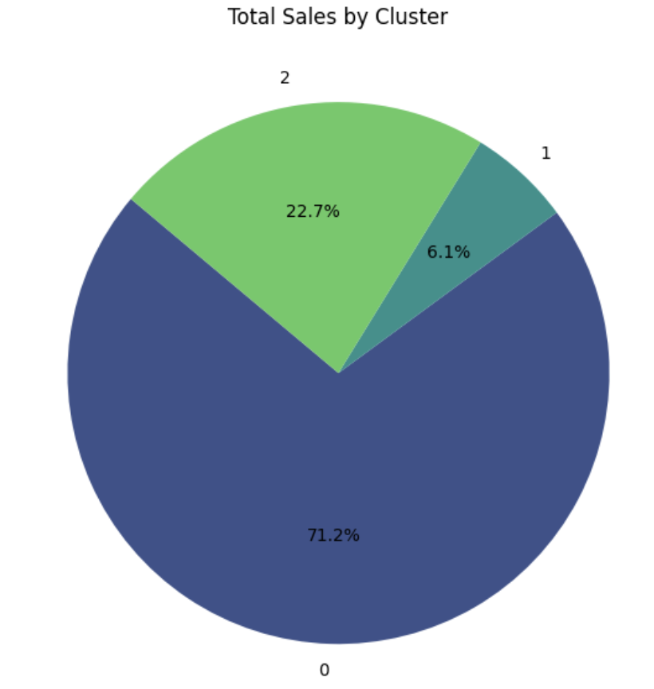
Interpreting Results in Business Context

Slide 9
Managerial Insights and Recommendations
Actionable Insights
High-Value Buyers(Cluster 2) : Exclusive loyalty programs and personalized offers.
Moderate Buyers(Cluster 0): Cross-sell, upsell, and seasonal promotions.
Inactive Buyers (Cluster 1): Reactivation campaigns and engagement surveys.
Overall: Develop data-driven pricing strategies and monitor customer feedback for continuous improvement.
Implementation Ideas:
Use real-time segmentation dashboards to track customer behavior.
Align marketing budgets with high-ROI segments.
Strategic Value:
Boost revenue through tailored customer strategies.
Enhance retention and reduce churn through proactive engagement.
Strengthen customer relationships by addressing specific needs and behaviors.
Establish a quarterly review process to reassess cluster assignments and adjust strategies accordingly.

